Slide 1
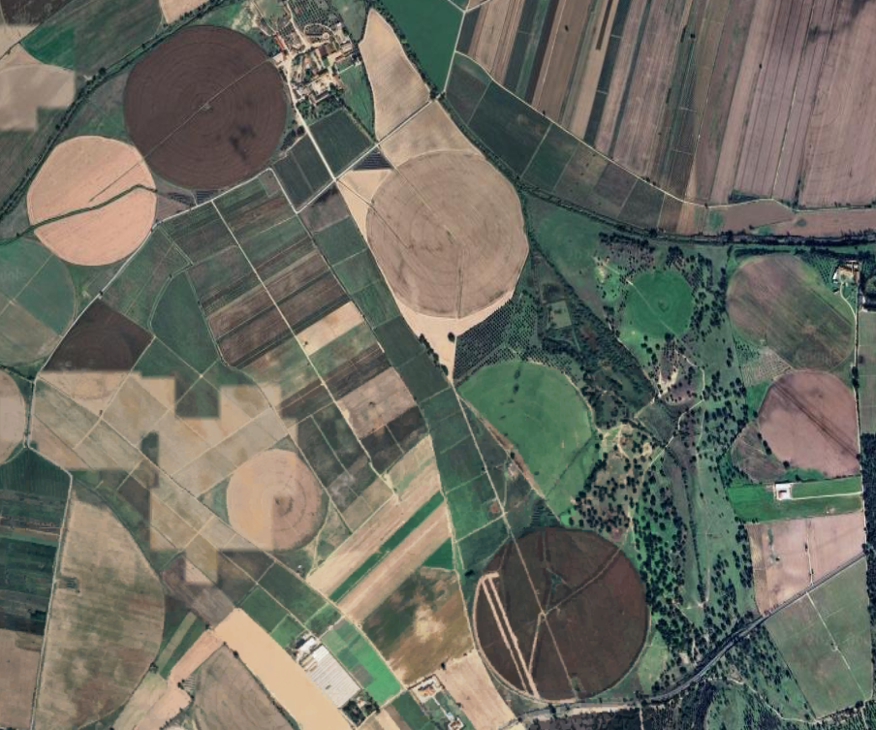
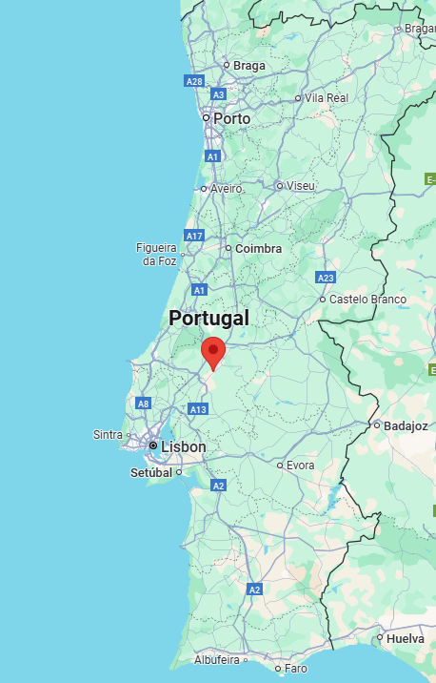
Site 1: Portugal
ood-t JAS2021 minicube_0_29SND_39.29_-8.56

Slide 2
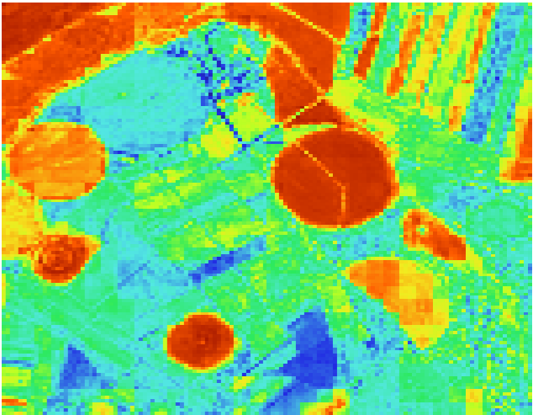
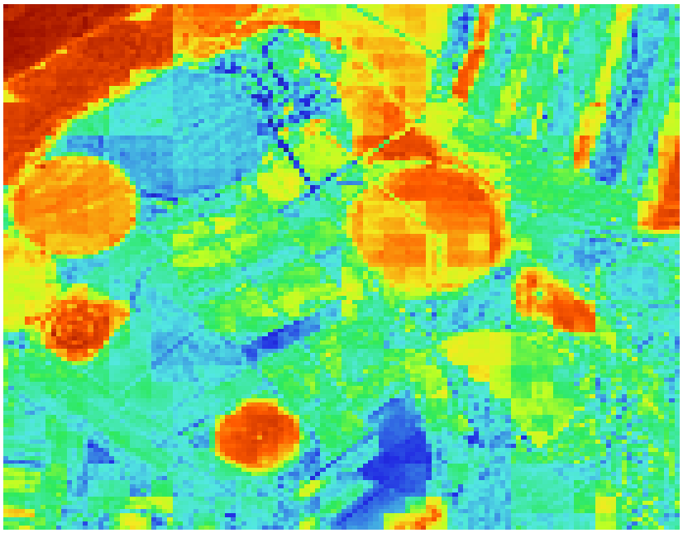
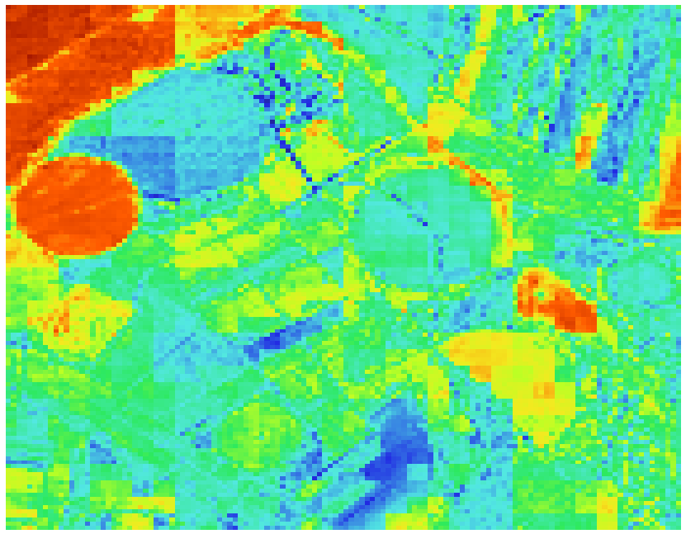
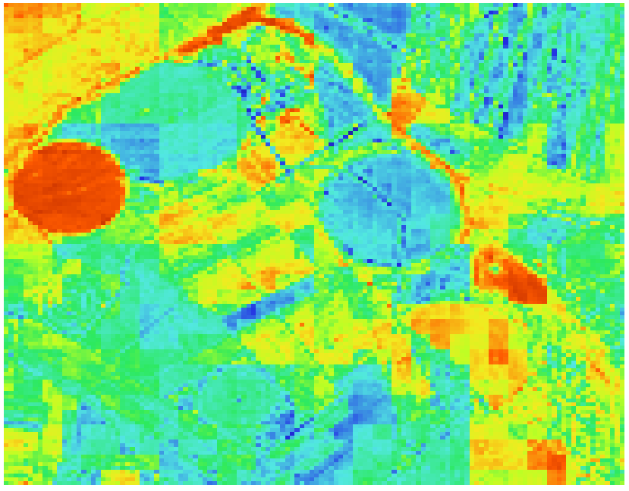
Predicted NDVI
Timestep 6 July 28
Timestep 10
August 17
Timestep 15
September 11
Timestep 20
October 6

Slide 3
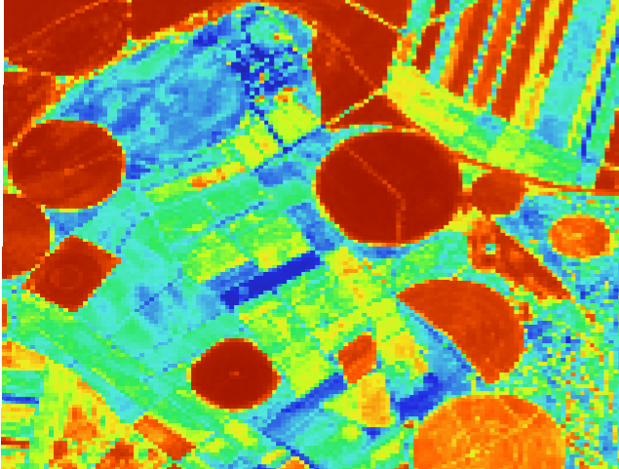
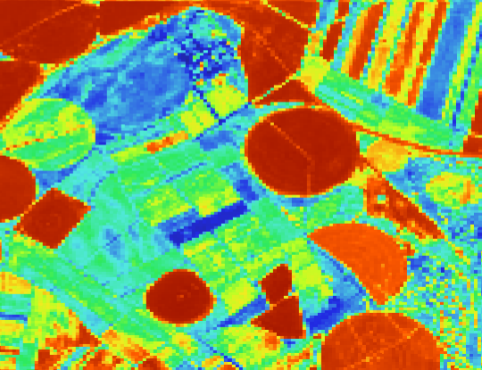
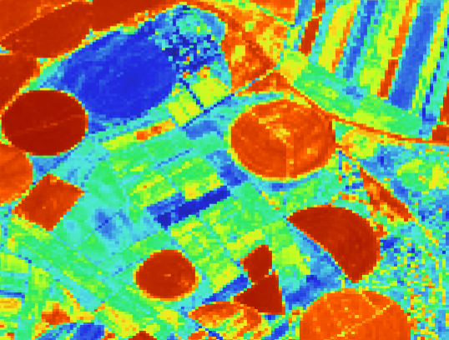
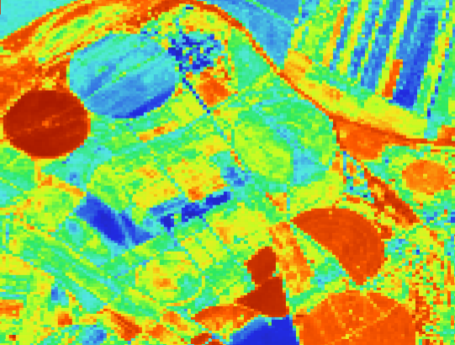
Actual NDVI
Timestep 6 July 28
Timestep 10
August 17
Timestep 15
September 11
Timestep 20
October 6

Slide 4
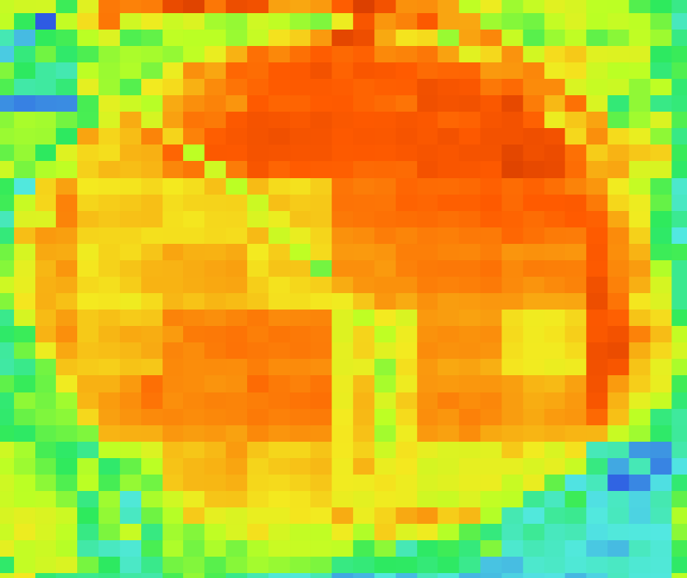
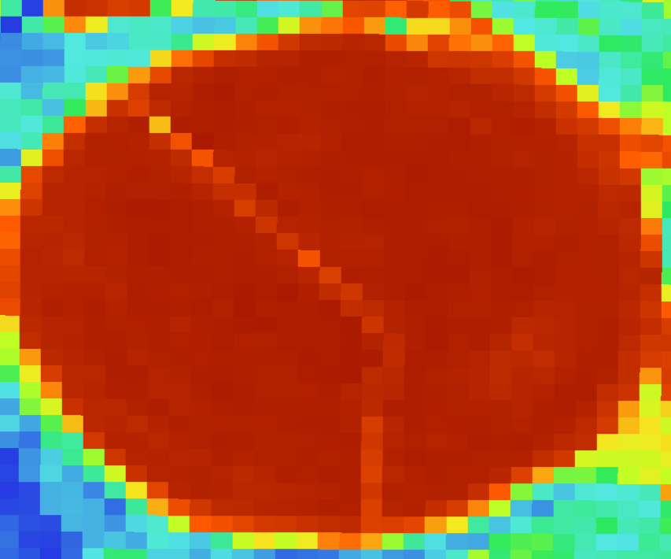
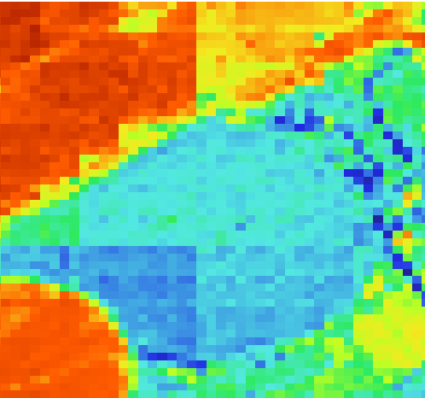
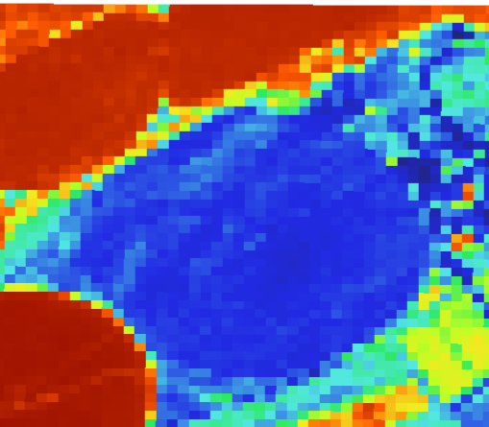
Artifacts
Predicted
Actual
Timestep 10 August 17
Timestep 15
September 11

Slide 5
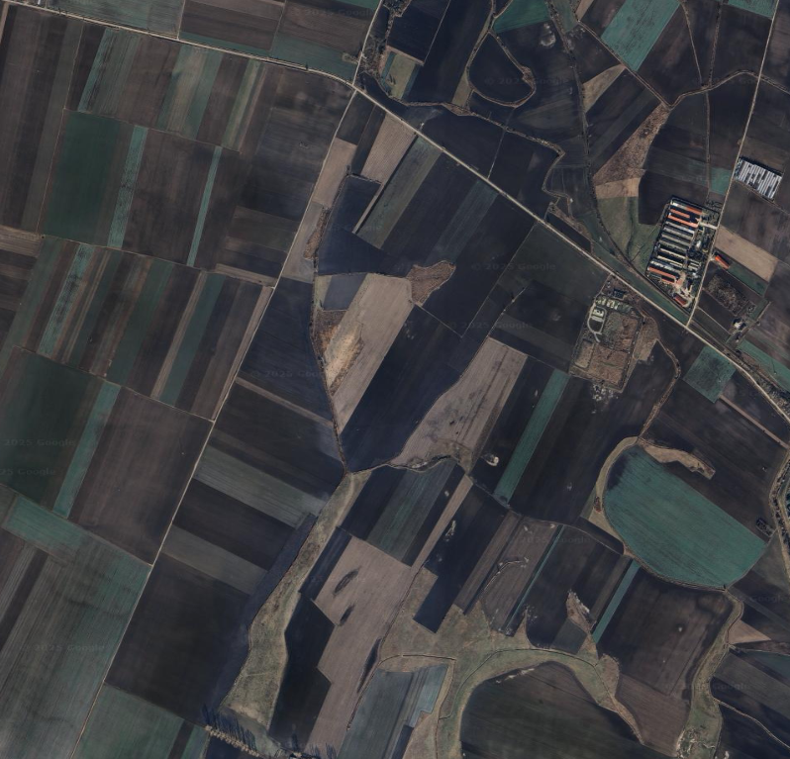
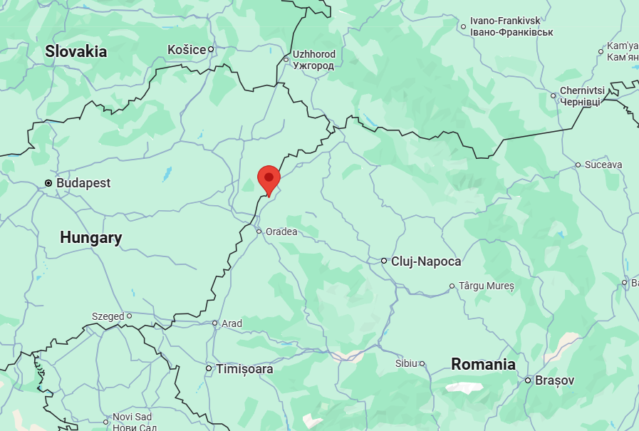
Site 2: Romania
ood-t MJJ2021 minicube_225_34TET_47.37_22.05

Slide 6
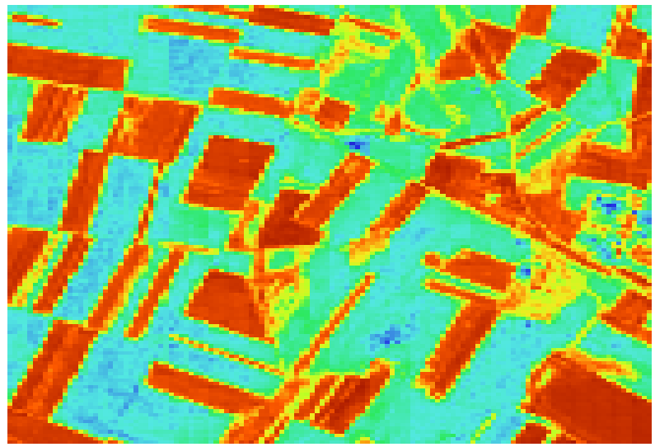
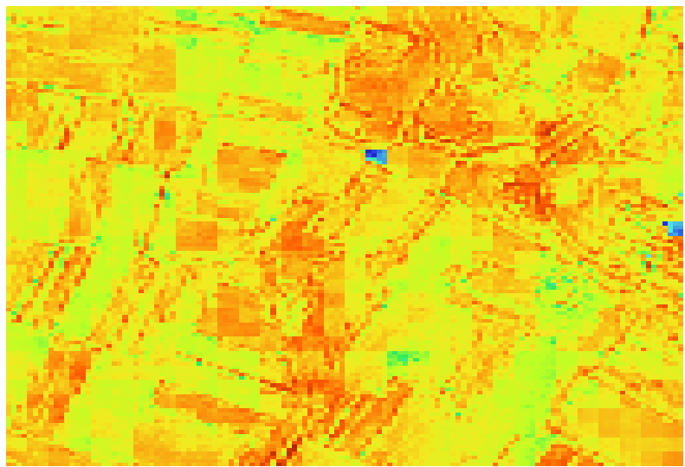
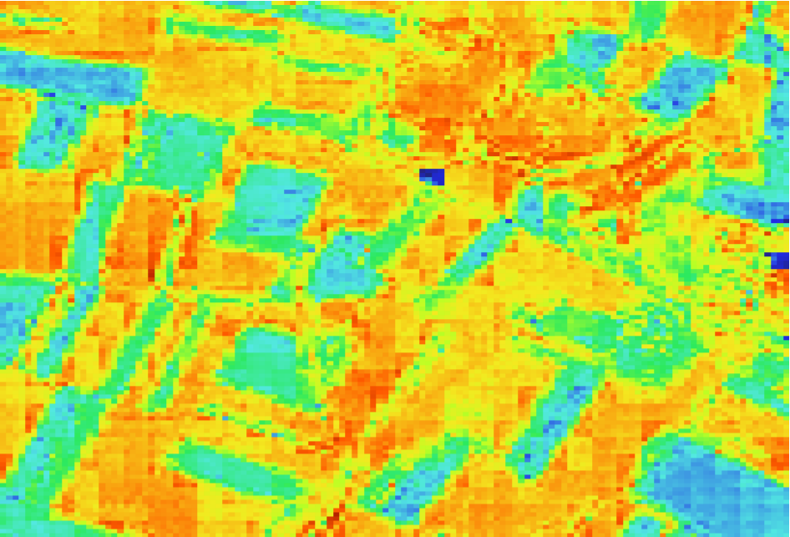
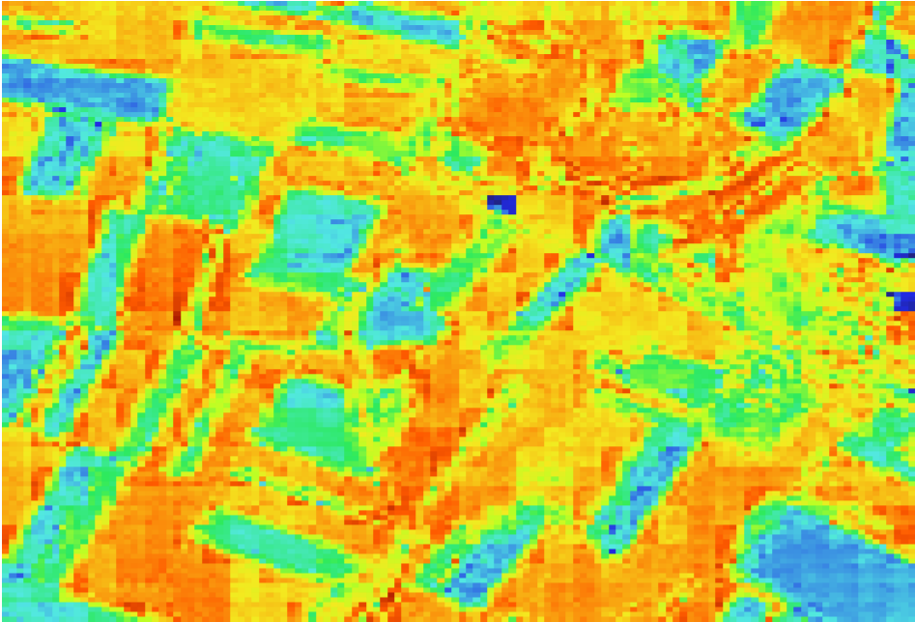
Predicted NDVI
Timestep 5
May 21
Timestep 10
June 15
Timestep 16
July 15
Timestep 19
July 30

Slide 7
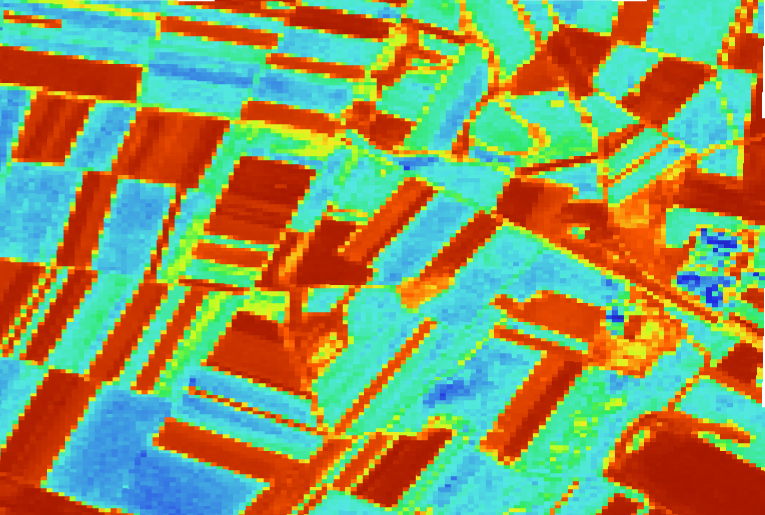
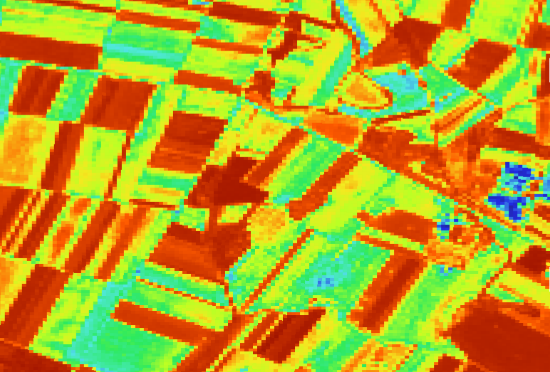
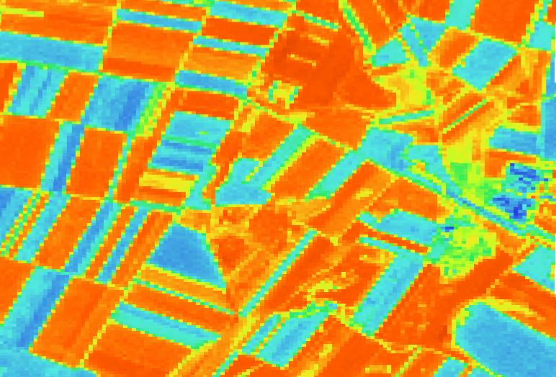
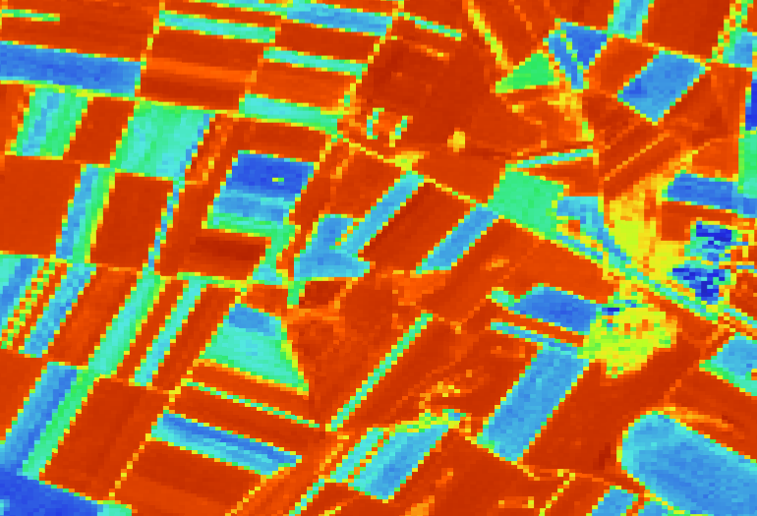
Actual NDVI
Timestep 5
May 21
Timestep 10
June 15
Timestep 16
July 15
Timestep 19
July 30

Slide 8
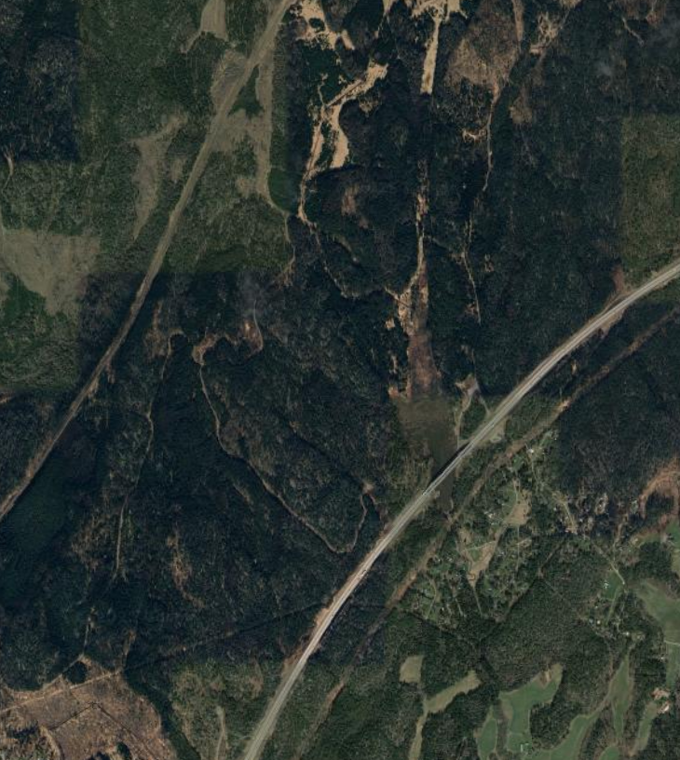
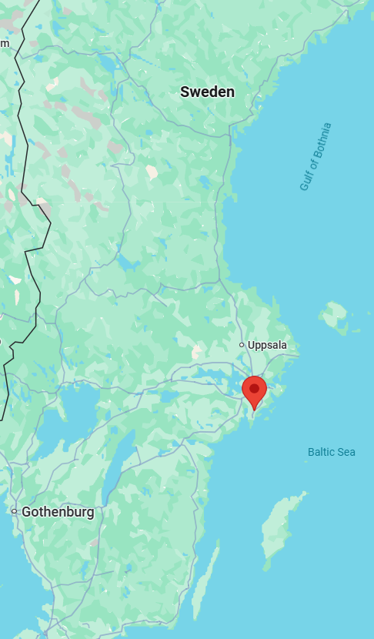
Site 3: Sweden
ood-t MJJ2021 minicube_241_34VCL_59.04_17.96

Slide 9
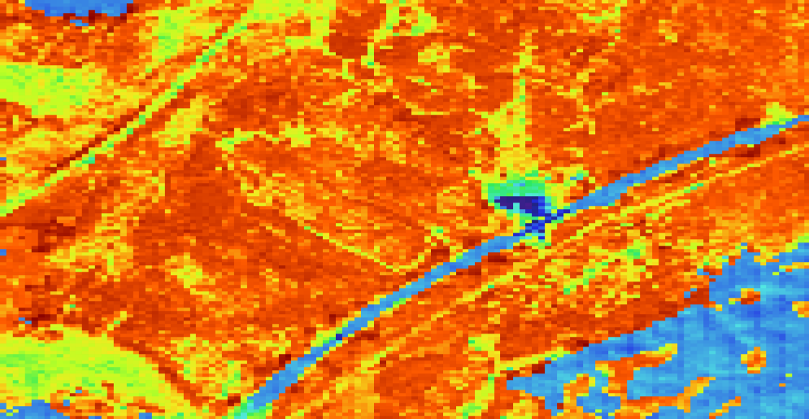
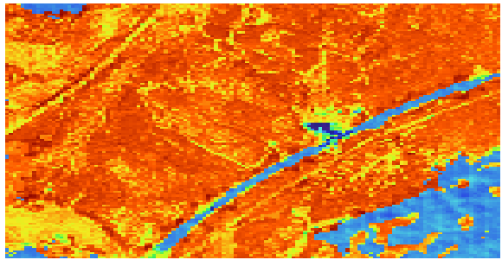
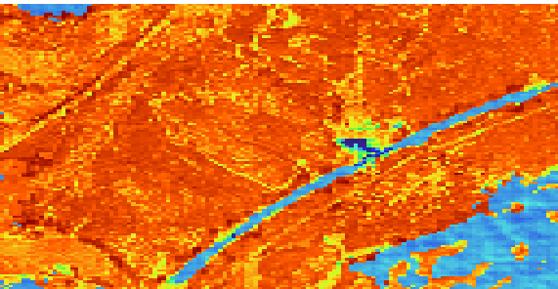
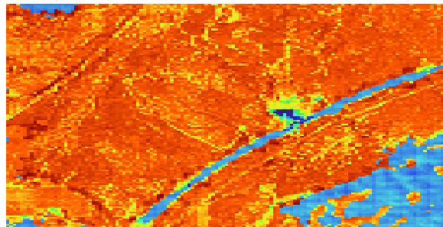
Predicted NDVI
Timestep 4
May 18
Timestep 10
June 17
Timestep 15 July 12
Timestep 20
August 6

Slide 10
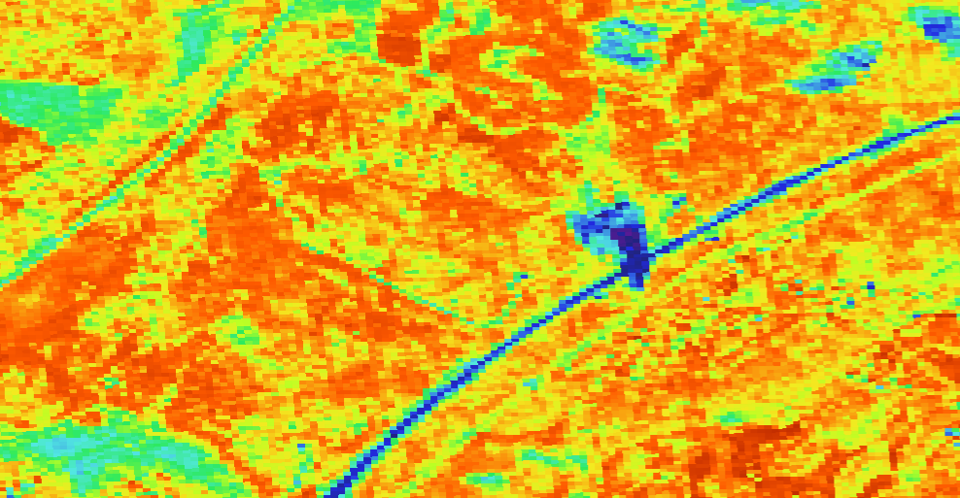
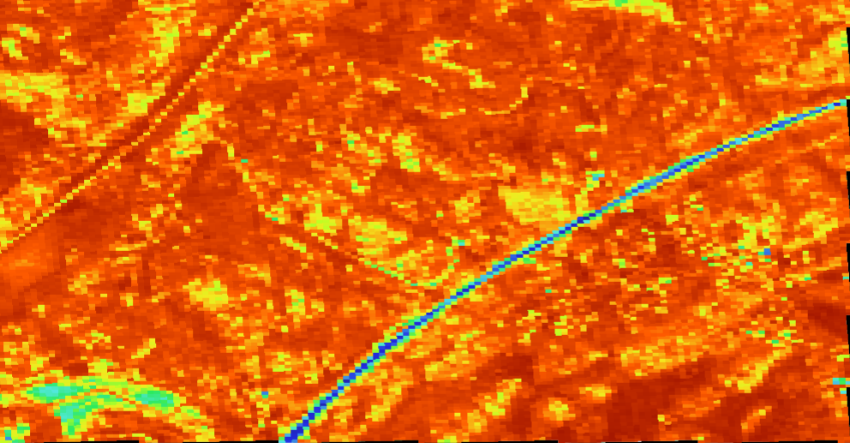
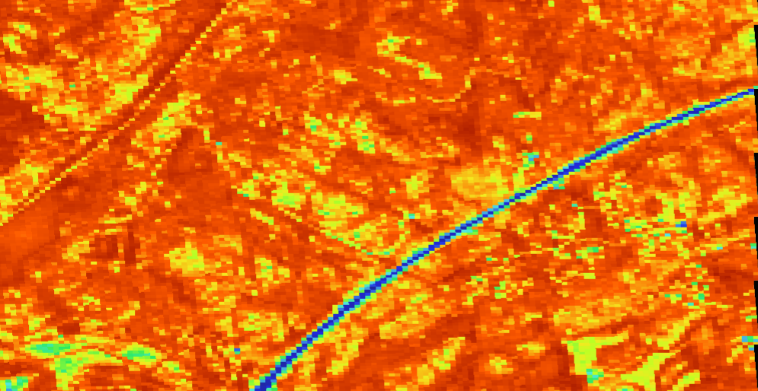
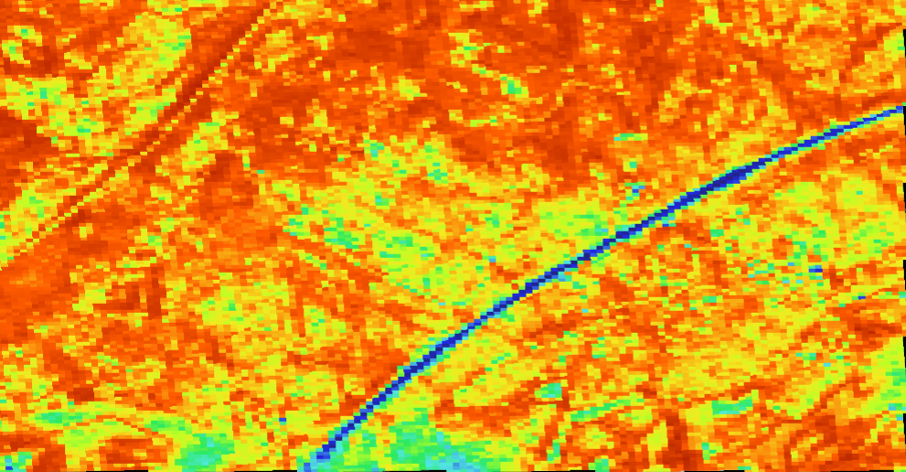
Actual NDVI
Timestep 4
May 18
Timestep 9.6
June 15
Timestep 15.6
July 15
Timestep 19.6
August 4
Note: There were cloud shadows in the bottom two thirds of the image

Slide 11
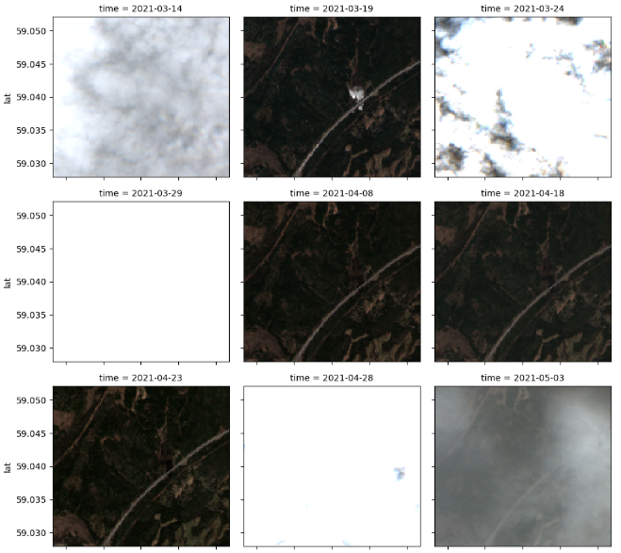
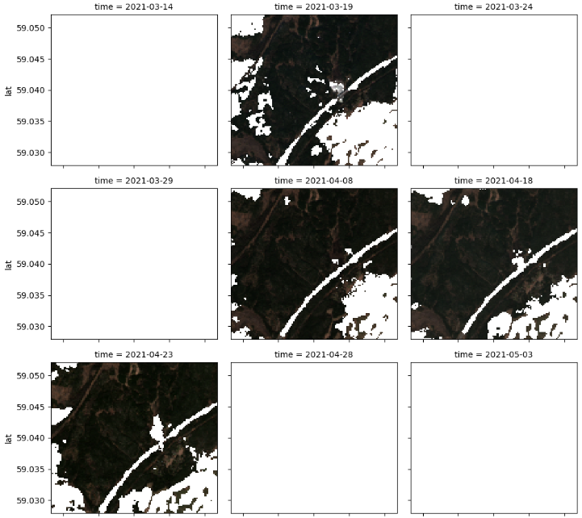
The custom cloud mask can be seen to mask the highway and the houses in the bottom right region
Clouds un-masked
Clouds masked

